Slide 1

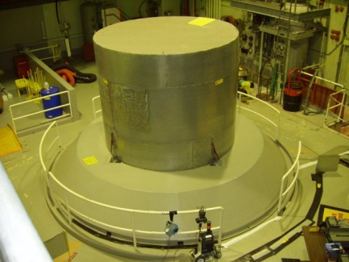
(Scenerio 1: All pumps monitor the Reactor)
H20 Cooler Pump
Start()
REACTOR
Liquid Nitrogen
Cooler Pump
SwitchOn()
How often do the pumps poll
the reactor?
Monitoring too often could affect
the overall system.
Electric, Boron
Cooler Pump
FireUp()
Notes:
Monitoring too often could affect the overall system:
The reactor software might be overloaded with incoming calls from pumps.
A pump may have to wait in a queue to get a temperature reading from the reactor, an so its start time might be delayed.

Slide 2
(Scenerio 2: Have a central Controller)
H20 Cooler Pump
Start()
REACTOR
Liquid Nitrogen
Cooler Pump
SwitchOn()
Monitors
Electric, Boron
Cooler Pump
Central
Controller
FireUp()
If there is a need to add a new pump then the software for the central controller needs to change.

